Slide 1


SHIFTING AIRLINES DATA INTO INSIGHTS
Analysis of Airlines Ratings Dataset Using SQL
By SOURAV CHOWHAN

Slide 2
OBJECTIVE
Analyse passenger reviews from the Airlines Ratings dataset
Identify patterns in satisfaction, comfort and service quality
Compare performance by seat class, aircraft type and route
Evaluate country-wise and traveller-type preferences
Highlight value for money opportunities and seasonal trends
Provide data-driven recommendations to improve customer experience

Slide 3

ANALYSIS
Popularity: Which routes and aircraft are most reviewed
Passenger experience: Ratings for comfort, staff, food and value
Market segmentation: Differences between Economy, Premium Economy, Business and First class
Geographical trends: Country-based satisfaction rates
Travellers’ profile analysis: Business, leisure couples, families, solo travellers
Improvement mapping: Identifying low-scoring service areas

Slide 4

WHAT IS MYSQL
SQL (Structured Query Language) is a standardized programming language designed for managing and manipulating relational databases.
It enables creating tables (structures), inserting data, querying information, updating records and deleting data.

Slide 5
SQL COMMANDOVERVIEW
DDL (Data Definition Language): Defines database schema — CREATE, ALTER, DROP, TRUNCATE
DML (Data Manipulation Language): Handles data within tables —
INSERT, UPDATE, DELETE.
DCL (Data Control Language): Manages access permissions — GRANT, REVOKE.
TCL (Transaction Control Language): Controls transactions — COMMIT, ROLLBACK.
DQL (Data Query Language): Queries data — SELECT.

Slide 6
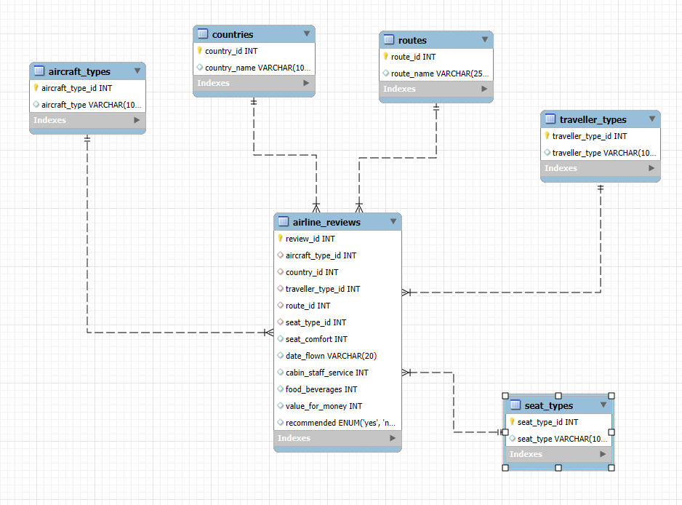
ER DIAGRAM
The main entities include:
Reviews: core table with passenger ratings and feedback indexed by review_id.
Aircraft_Type: stores aircraft models.
Countries: country of origin or service.
Travellers_Type: business, leisure, family, solo, etc.
Routes: origin-destination pairs.
Seat_Types: economy, premium economy, business, first class.

Slide 7
SCHEMA CREATION
create DATABASE airlines_rating_db;
USE airlines_rating_db;

Slide 8
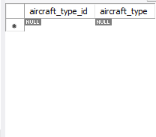
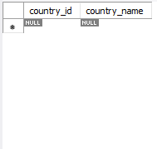
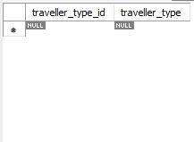
TABLE CREATION
CREATE TABLE aircraft_types (
aircraft_type_id INT AUTO_INCREMENT PRIMARY KEY,
aircraft_type VARCHAR(100)
);
CREATE TABLE countries (
country_id INT AUTO_INCREMENT PRIMARY KEY,
country_name VARCHAR(100)
);
CREATE TABLE traveller_types (
traveller_type_id INT AUTO_INCREMENT PRIMARY KEY,
traveller_type VARCHAR(100)
);

Slide 9
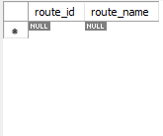
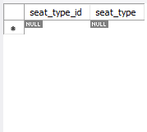
CREATE TABLE routes (
route_id INT AUTO_INCREMENT PRIMARY KEY,
route_name VARCHAR(255)
);
CREATE TABLE seat_types (
seat_type_id INT AUTO_INCREMENT PRIMARY KEY,
seat_type VARCHAR(100)
);

Slide 10
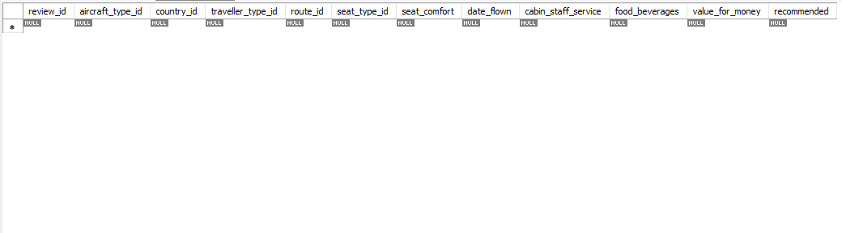
CREATE TABLE airline_reviews (
review_id INT AUTO_INCREMENT PRIMARY KEY,
aircraft_type_id INT,
country_id INT,
traveller_type_id INT,
route_id INT,
seat_type_id INT,
seat_comfort INT,
date_flown VARCHAR(20),
cabin_staff_service INT,
food_beverages INT,
value_for_money INT,
recommended ENUM('yes','no'),
FOREIGN KEY (aircraft_type_id) REFERENCES aircraft_types(aircraft_type_id),
FOREIGN KEY (country_id) REFERENCES countries(country_id),
FOREIGN KEY (traveller_type_id) REFERENCES traveller_types(traveller_type_id),
FOREIGN KEY (route_id) REFERENCES routes(route_id),
FOREIGN KEY (seat_type_id) REFERENCES seat_types(seat_type_id)
);

Slide 11
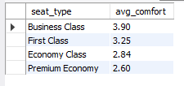
MY ANALYSIS ON THE AIRLINE DATABASE WITH THE QUERY
Average Seat Comfort by Seat Type
SELECT s.seat_type, ROUND(AVG(ar.seat_comfort), 2) AS avg_comfort
FROM airline_reviews ar
JOIN seat_types s ON ar.seat_type_id = s.seat_type_id
GROUP BY s.seat_type
ORDER BY avg_comfort DESC;

Slide 12
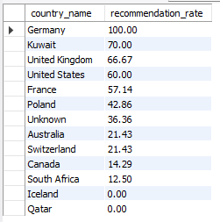
Country-wise Recommendation Rate
SELECT c.country_name,
ROUND(AVG(CASE WHEN ar.recommended = 'yes' THEN 1 ELSE 0 END) * 100, 2) AS recommendation_rate
FROM airline_reviews ar
JOIN countries c ON ar.country_id = c.country_id
GROUP BY c.country_name
ORDER BY recommendation_rate DESC;

Slide 13
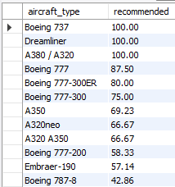
Aircraft Type Performance (Recommendation Rate)
SELECT at.aircraft_type,
ROUND(AVG(CASE WHEN ar.recommended = 'yes' THEN 1 ELSE 0 END) * 100, 2) AS recommended
FROM airline_reviews ar
JOIN aircraft_types at ON ar.aircraft_type_id = at.aircraft_type_id
GROUP BY at.aircraft_type
ORDER BY recommended DESC;

Slide 14
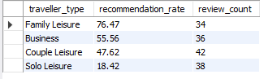
Traveller Type Recommendation Trends
SELECT tt.traveller_type,
ROUND(AVG(CASE WHEN ar.recommended = 'yes' THEN 1 ELSE 0 END) * 100, 2) AS recommendation_rate,
COUNT(*) AS review_count
FROM airline_reviews ar
JOIN traveller_types tt ON ar.traveller_type_id = tt.traveller_type_id
GROUP BY tt.traveller_type
ORDER BY recommendation_rate DESC;

Slide 15
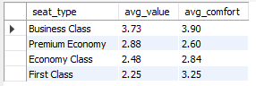
Value for Money vs Seat Comfort Analysis
SELECT s.seat_type,
ROUND(AVG(ar.value_for_money), 2) AS avg_value,
ROUND(AVG(ar.seat_comfort), 2) AS avg_comfort
FROM airline_reviews ar
JOIN seat_types s ON ar.seat_type_id = s.seat_type_id
GROUP BY s.seat_type
ORDER BY avg_value DESC;

Slide 16
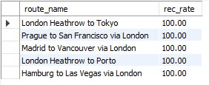
5 Best Performing Routes by Recommendation Rate
SELECT r.route_name,
ROUND(AVG(CASE WHEN ar.recommended = 'yes' THEN 1 ELSE 0 END) * 100, 2) AS rec_rate
FROM airline_reviews ar
JOIN routes r ON ar.route_id = r.route_id
GROUP BY r.route_name
ORDER BY rec_rate DESC
limit 5;

Slide 17
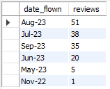
Monthly Review Distribution
SELECT date_flown, COUNT(*) AS reviews
FROM airline_reviews
GROUP BY date_flown
ORDER BY reviews DESC;

Slide 18
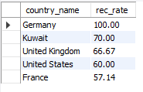
Top 5 Countries with highest Recommendation Rate
SELECT c.country_name,
ROUND(AVG(CASE WHEN ar.recommended = 'yes' THEN 1 ELSE 0 END) * 100, 2) AS rec_rate
FROM airline_reviews ar
JOIN countries c ON ar.country_id = c.country_id
GROUP BY c.country_name
ORDER BY rec_rate desc
LIMIT 5;

Slide 19
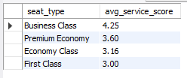
Service Quality Ranking by Seat Type
SELECT s.seat_type,
ROUND(AVG(ar.cabin_staff_service),2) AS avg_service_score
FROM airline_reviews ar
JOIN seat_types s ON ar.seat_type_id = s.seat_type_id
GROUP BY s.seat_type
ORDER BY avg_service_score DESC;

Slide 20
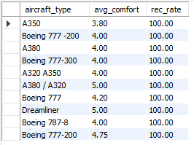
Top 10 Aircraft for Business Class Travellers
SELECT at.aircraft_type,
ROUND(AVG(ar.seat_comfort),2) AS avg_comfort,
ROUND(AVG(CASE WHEN ar.recommended = 'yes' THEN 1 ELSE 0 END) * 100, 2) AS rec_rate
FROM airline_reviews ar
JOIN aircraft_types at ON ar.aircraft_type_id = at.aircraft_type_id
JOIN seat_types s ON ar.seat_type_id = s.seat_type_id
WHERE s.seat_type = 'Business Class'
GROUP BY at.aircraft_type
ORDER BY rec_rate DESC
limit 10;

Slide 21
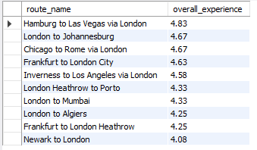
Top Routes by Overall Experience Score
SELECT r.route_name,
ROUND(AVG((IFNULL(ar.seat_comfort,0) + IFNULL(ar.cabin_staff_service,0) +
IFNULL(ar.`food_beverages`,0) + IFNULL(ar.value_for_money,0))/4), 2) AS overall_experience
FROM airline_reviews ar
JOIN routes r ON ar.route_id = r.route_id
GROUP BY r.route_name
ORDER BY overall_experience DESC
LIMIT 10;

Slide 22

CONCLUSION
This data-driven analysis offers an insightful view into passenger experiences across airlines, routes, seating categories and traveller types.
By leveraging SQL to explore ratings and recommendations, clear patterns have emerged on where airlines succeed and where improvements are needed.
Such insights empower targeted service enhancements, strategic marketing focus and optimized operational planning to boost passenger satisfaction and loyalty.

Slide 23

THANK YOU

